Slide 1



Parcel Label Field Completeness Inspection
AiScream
Team Members:
Siti Radhiah Binti Megat Azahari
Hazwani Binti Yusoff
Aizatul Afina Binti Ahmad Suhaimi
Umie Umaira Binti Mohamad Azhar

Slide 2
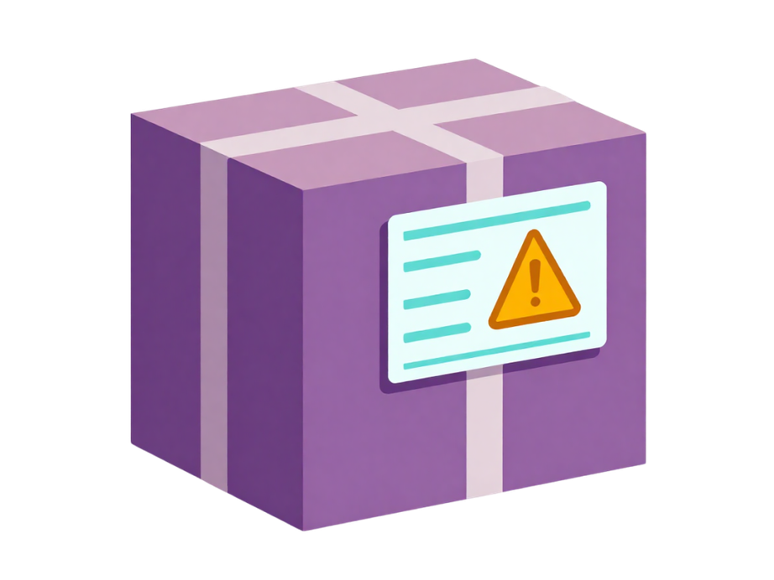
Problem Statement
Manually checking parcel labels can be a hassle for staff, especially when many parcels need to be processed. Missing required fields may cause delivery delays, rejected parcels, and additional rework

Slide 3
Project Objective
Detect five essential fields on a parcel label
Identify filled and empty fields
Read and display label information on a dashboard
Save inspection results for future reference

Slide 4

Use Case: Warehouse Label Inspection
Staff prepare a parcel label and place it in front of the camera. The system checks required fields before the parcel continues to dispatch. Incomplete labels are corrected immediately.

Slide 5
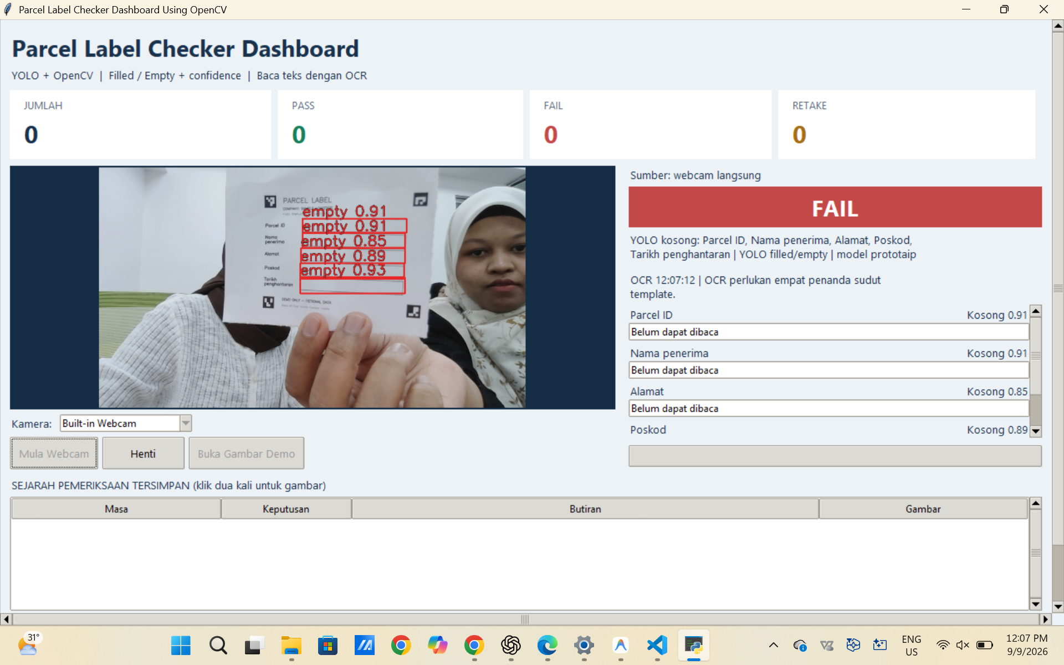
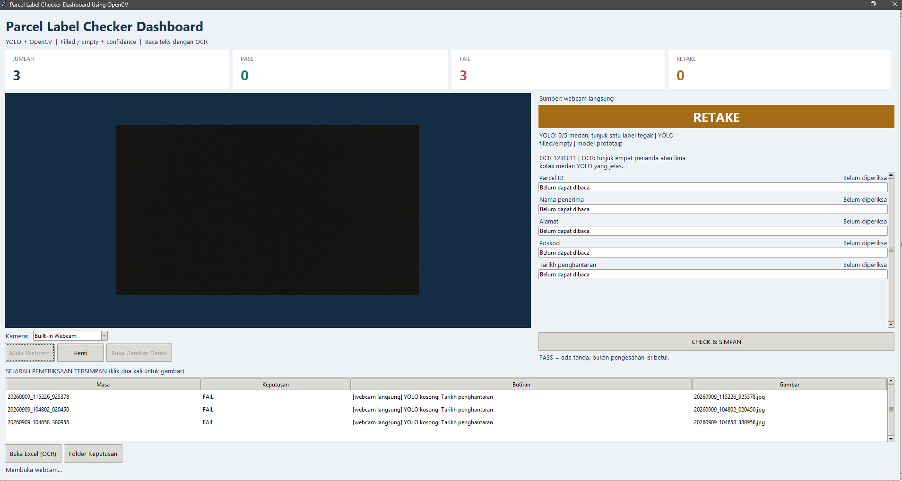
System Overview
1. The camera captures the parcel label
2. YOLO detects fields and classifies them as filled or empty
3. Green or red bounding boxes appear with confidence scores
4. OCR automatically reads the text
5. The dashboard displays each field’s status and recognised text
6. The user clicks *CHECK & SAVE* to record the inspection

Slide 6
Technology Used
Python:
Programming language
OpenCV:
Image processing and label alignment
YOLO11n:
Detects filled and empty fields with confidence scores
RapidOCR:
Reads text using a pretrained model
Camera:
Qualcomm RB3 or a built-in webcam

Slide 7
Target Market
Primary target: Warehouses and logistics companies.
Secondary target: E-commerce sellers, courier-service branches, and packaging companies.
Users: Packaging staff, quality-control inspectors, warehouse supervisors, and dispatch teams.
These organisations handle many parcels daily and need a simple way to check label completeness before dispatch.

Slide 8
Value Proposition
Reduces the hassle of manually checking every parcel label.
Identifies incomplete labels before parcels leave the warehouse.
Reduces delivery delays, rejected parcels, and rework.
Provides visual proof and inspection records for quality control.
Can run at the edge using a camera device, reducing dependence on cloud processing.

Slide 9
Revenue Model
Hardware + setup fee: Charge customers for the camera device, installation, label-template configuration, and staff training.
Monthly subscription: Charge a monthly fee for dashboard access, inspection history, updates, and technical support.
Enterprise/customisation fee: Charge extra for custom label templates, multiple inspection stations, integration with warehouse systems, or OCR features.
Maintenance service: Offer periodic calibration, system maintenance, and model/template updates.

Slide 10
Inspection Results
PASS: All five fields are detected and classified as filled.
FAIL: All five fields are detected, but at least one is classified as empty.
RETAKE: the detected field count or arrangement does not meet the inspection requirements.
OCR text is saved in a CSV file that can be opened in Excel. Images and inspection details are also stored.

Slide 11
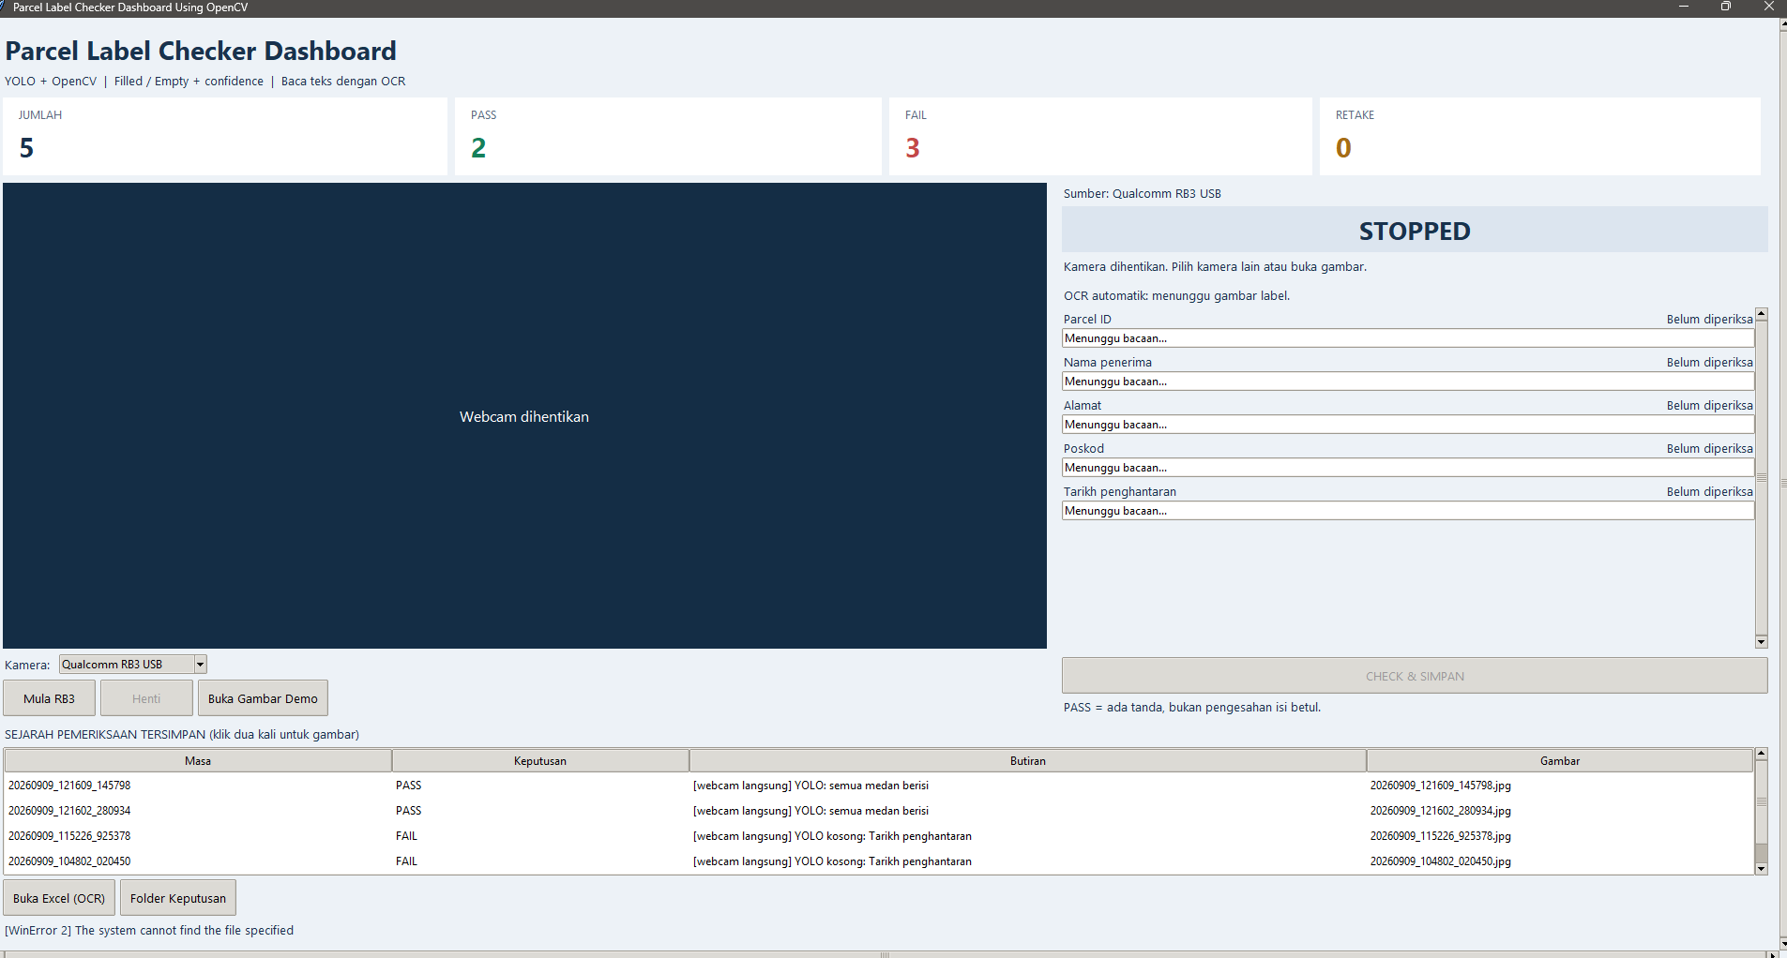
Dashboard Example

Slide 12
Results
All filled/empty combinations on the demo template passed detection checks.
OCR successfully read four demo label examples.
The YOLO11n model was trained using synthetic images.
Limitations
Blur, reflections and camera angles can affect results.
The system does not verify whether an address, date or other information is valid.

Slide 13
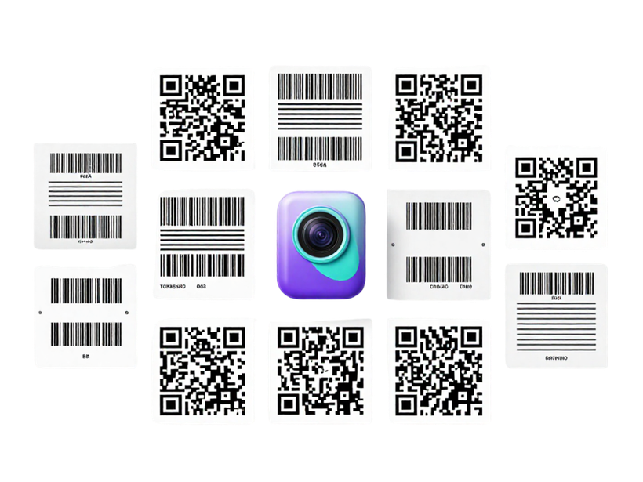
Future Improvements
Add real camera images for training and evaluation
Support different label layouts
Validate parcel ID, postcode and date formats
Trace parcel per batch number.
Add barcode or QR code reading
Test the system in an actual parcel inspection workflow

Slide 14
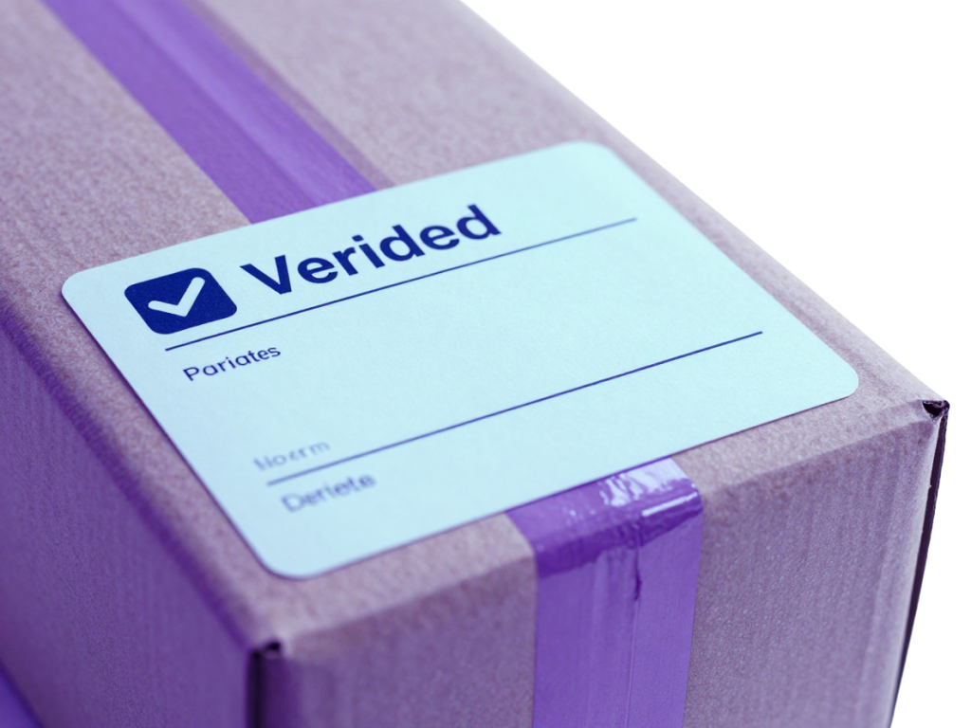
Thank
You
For Your Attention

